Slide 1

Sant Dnyaneshwar Shikshan Sanstha's
Annasaheb Dange College of Engineering and Technology (ADCET), Ashta
(An Empowered Autonomous lnstitute affiliated to Shivaji University, Kolhapur)
Department of Civil Engineering
2025-26
Synopsis Presentation
AirShield: An IoT-Enabled Indoor Air Quality Monitoring and Alert System
Group Members: | Roll Number: | URN:
Sumit Parihar | 24 | 23031138
Barsha Gupta | 25 | 23031139
Akshita Jha | 31 | 23101051
Pranav Bhale | 43 | 23011075

Slide 2
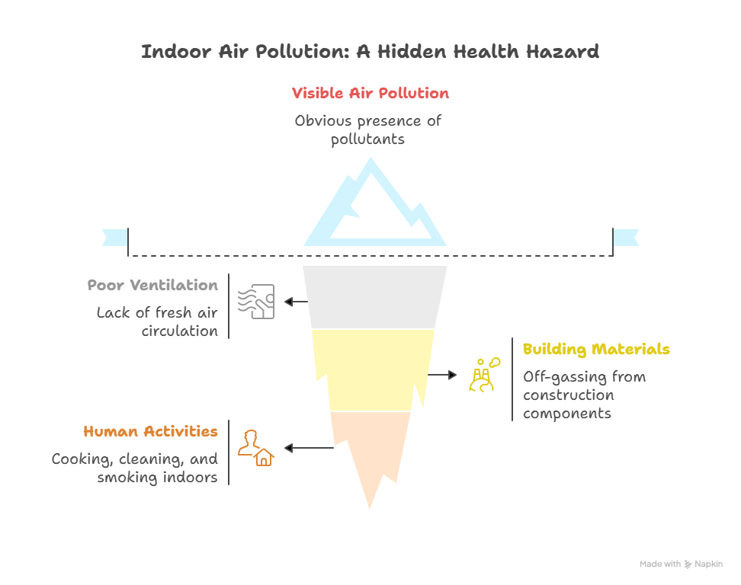
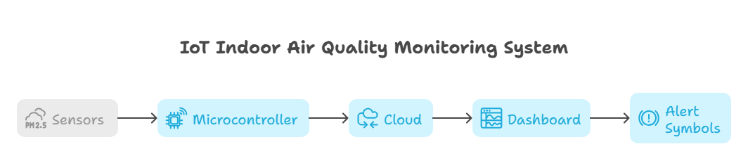
INTRODUCTION
Proposed Solution:
AirShield: An IoT-based system for real-time indoor air quality monitoring.
Monitors CO₂, VOCs, PM2.5, temperature, and humidity.
Provides threshold-based alerts (LED, buzzer, SMS/Telegram).
Visualizes data on an interactive dashboard for quick awareness.
Uniqueness of Solution:
Low-cost and accessible for classrooms, hostels, and offices.
Provides real-time monitoring with simple predictive/alerting capability.
Combines IoT sensors + cloud dashboard + alert system in one compact solution.
Includes simple comfort/health indicator (green/yellow/red) — not just raw values.
Problem:
Indoor air pollution often goes unnoticed.
Causes: CO₂ buildup, VOCs, PM2.5, humidity fluctuations, poor ventilation.
Effects: headaches, fatigue, reduced productivity, respiratory issues.
Existing solutions are often expensive, reactive, or limited to commercial settings.

Slide 3
LITERATURE REVIEW
Title: | Author: | Year: | Key Findings:
Machine learning and statistical models for predicting indoor air quality | Wenjuan Wei et al. | 2021 | Reviewed ML/statistical models (ARIMA, LSTM) for indoor air prediction; highlights potential of forecasting but lacks real-time low-cost deployment.
Indoor Air Quality Monitoring: Sensors and Applications | S. Sharma & P. Kumar | 2020 | Discusses various low-cost sensors (CO₂, PM2.5, VOCs); shows need for affordable solutions for classrooms and offices.
Framework for Indoor Air Quality Estimation and Forecasting | IndoAirSense Team | 2021 | Developed ML-based prediction for classrooms; limited to controlled environments, expensive sensors, no real-time alerts for small rooms.
Indoor Air Quality Solutions | Neptronic Documentation | 2022 | Commercial solutions provide dashboards and alerts; mostly reactive, high-cost, not designed for small-scale deployment.

Slide 4


PROBLEM STATEMENT AND SCOPE OF THE PROJECT
Problem Statement
Scope of the Project
Indoor air quality in educational spaces often deteriorates unnoticed, yet it strongly influences student health, concentration, and academic performance.
Poor ventilation causes a buildup of CO₂, PM2.5, and VOCs — leading to fatigue, headaches, and respiratory issues.
Existing solutions are expensive, reactive, and not suited for small indoor spaces.
There is a need for a low-cost, smart system that monitors and predicts air quality in real time.
The system focuses solely on indoor air quality monitoring for environments like classrooms, hostels, and offices.
It uses low-cost sensors and microcontrollers (ESP32/NodeMCU) to collect and transmit environmental data.
Cloud platforms (e.g., ThingSpeak/Firebase) are used for data storage and retrieval.
Includes a user-friendly dashboard and alert system but does not control hardware like purifiers or HVAC systems

Slide 5
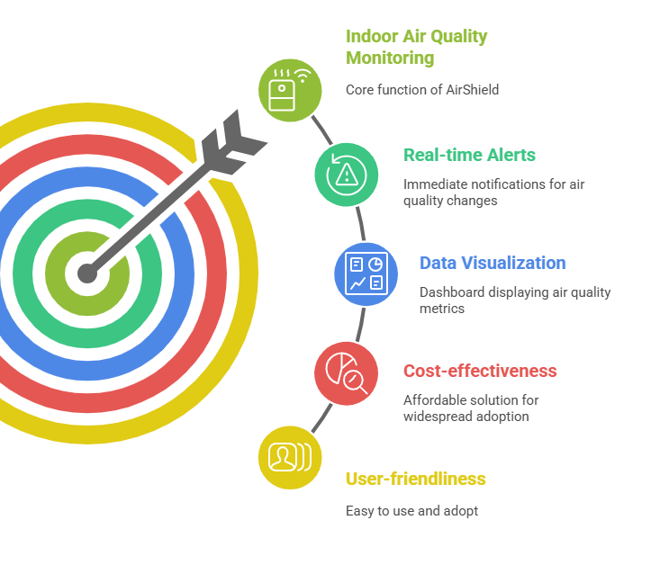
OBJECTIVES
Design and implement
To design and implement AirShield, an IoT-based indoor air quality monitoring system for classrooms, hostels, and small indoor spaces.
Measure
To continuously measure key parameters: CO₂, PM2.5, VOCs, temperature, and humidity.
Provide
To provide threshold-based alerts through LEDs, buzzers, and SMS/Telegram notifications when air quality is unsafe.
Display
To display real-time data and historical trends on an interactive dashboard for easy monitoring.

Slide 6
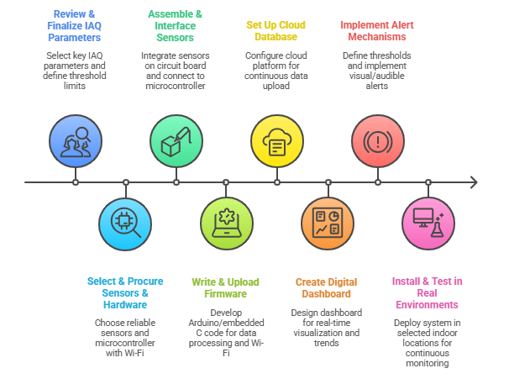
METHODOLOGY

Slide 7
REFERENCES
Wenjuan Wei et al., “Machine learning and statistical models for predicting indoor air quality,” 2021. https://www.ncbi.nlm.nih.gov/pmc/articles/PMC7420173/
S. Sharma & P. Kumar, Indoor Air Quality Monitoring: Sensors and Applications, 2020.
IndoAirSense Team, Framework for Indoor Air Quality Estimation and Forecasting, 2021. https://www.mdpi.com/2071-1050/13/21/11855?utm_source=chatgpt.com
Neptronic Documentation, Indoor Air Quality Solutions, 2022. https://www.neptronic.com/ims/iaq/index.html
World Health Organization, Air Quality Guidelines, 2021.
ThingSpeak API Documentation: https://thingspeak.com/docs
Streamlit Documentation: https://docs.streamlit.io

